Slide 1
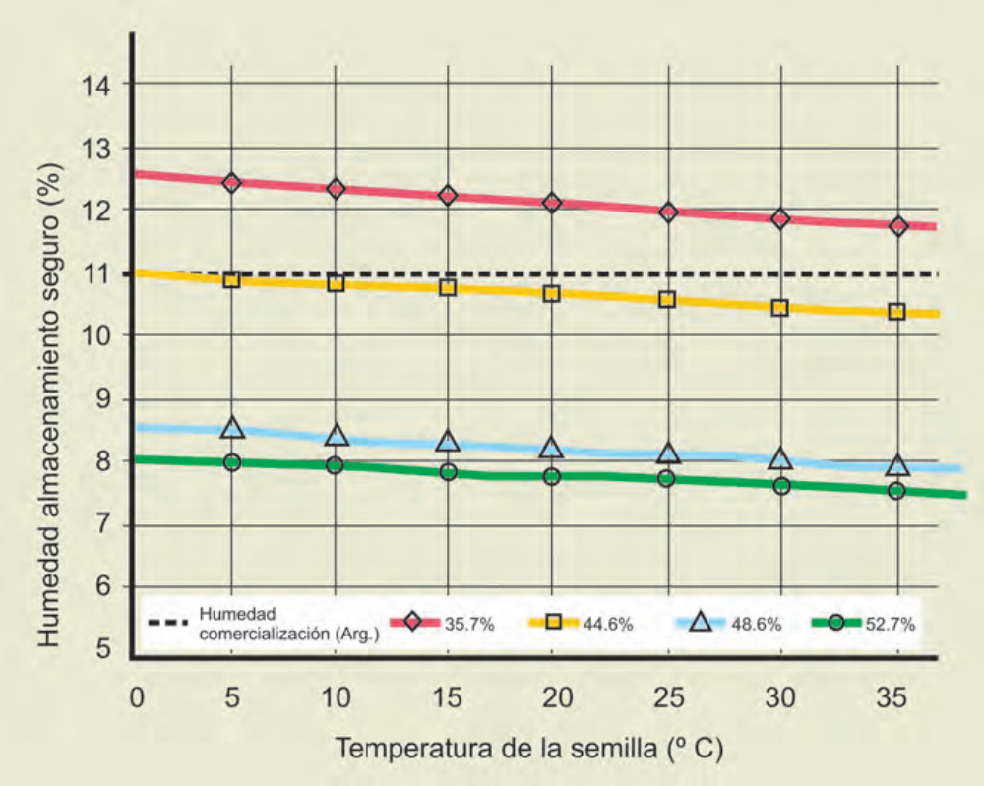
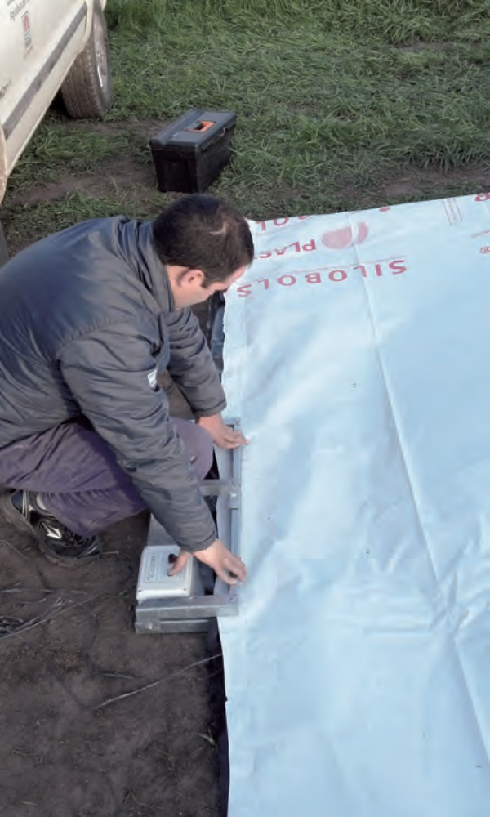
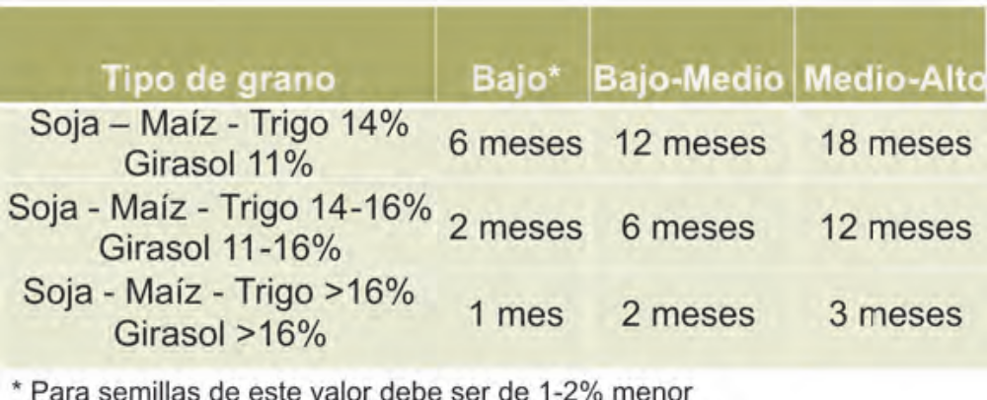
Title
Authors
¹Affiliation, e-mail
Introduction
Methodology
Description of the context, problem and objectives (ARIAL, 20)
Description of matherials and methods (ARIAL, 20).
Results
IInclude figures, tables, and images (Arial, 20)
Conclusions
Enumerate the most important conclusions (Arial, 20)
Xxxxxx
Xxxxxx
Xxxxxx
xxxxxxx

